Slide 1
Lecture 20 – Software Systems Engineering and Integration
Notes:
A good reference for this lecture is “Software Systems Engineering” by Sage and Palmer , 1990, Wiley and Sons – Wiley Series in Systems Engineering. This is just an introduction to a subject that can be a course in its own. Many ofd the elements of good systems engineering, such as requirements traceability, the integration V, rapid spiral development and interfaces control apply equally well to software virtual systems as well as real physical systems. This lecture attempts to address the unique aspects of software systems engineering.

Slide 2
Good Software Engineering is Good Systems Engineering
Software usually consists of many parts
  Software modules
  Data
Each of these have structure
Each of these has interfaces
Each of these has desired function
Pitting them together is putting together a large virtual system
Notes:
It is interesting to note that many of the concepts in modern systems engineering originated in software engineering. For example, the Capability Maturity Model started as a software engineering initiative and then grew to encompass all systems engineering. Independent Verification nd Validation (IV&V) started as software engineering concept and then migrated into larger systems.,

Slide 3
Levels of Software Requirements
Level A – System requirements – what does the entire system of programs have to do
  Data flow diagrams very useful in Level A
Level B – by module or function – detailed functional requirements – what not how
Level C – by module or function – design to requirements, identify specific algorithms (procedures, calculations) to be used
A Verification Plan (Test Plan) should identify for each requirement whether it will be verified by Inspection, Test, Analysis or Demonstration (ITAD) as discussed in previous lectures.
Previously discussed rules for requirements (e.g. avoiding negative requirements, use of shall and will) apply equally well to software systems as hardware systems.

Slide 4
Key Performance Parameters (KPPs) and Technical Performance Metrics (TPMs) for software
Software Lines of Code (SLOC) – how many lines of software
  Used to describe pre-design allocations
  Used to track % complete
  Used to evaluate size and complexity
  Still a very common measure for productivity although use of Software through pictures tools like LabVIEW and Simulink have degraded their usefulness
    LabVIEW has a tool which counts nodes and connections and each node/connection counts as a SLOC
  Still valid for traditional languages like C or C++
Complexity Measures
  Algorithms analyze code and generate complexity metrics by a variety of techniques
  Good risk metric
Total Paths
  code analysis to count the number of possible branches
  Used to evaluate how effective testing is – what percentage of the possible branches have been covered in test
Memory size of executable
Speed to complete one pass through main loop of a program or to complete one processing task
Latency – time from one input to complete response

Slide 5
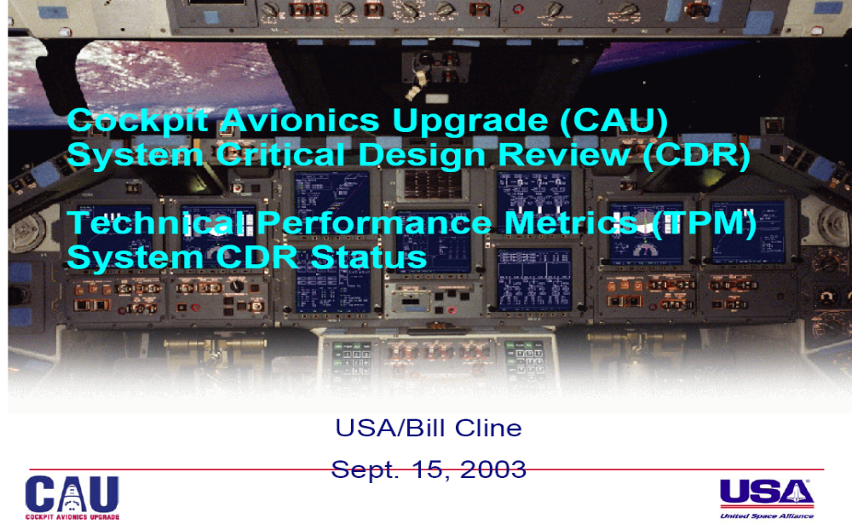
Notes:
This is a presentation on tracking the Technical Performance Metrics on the Cockpit Avionics Upgrade for the Space Shuttle.

Slide 6
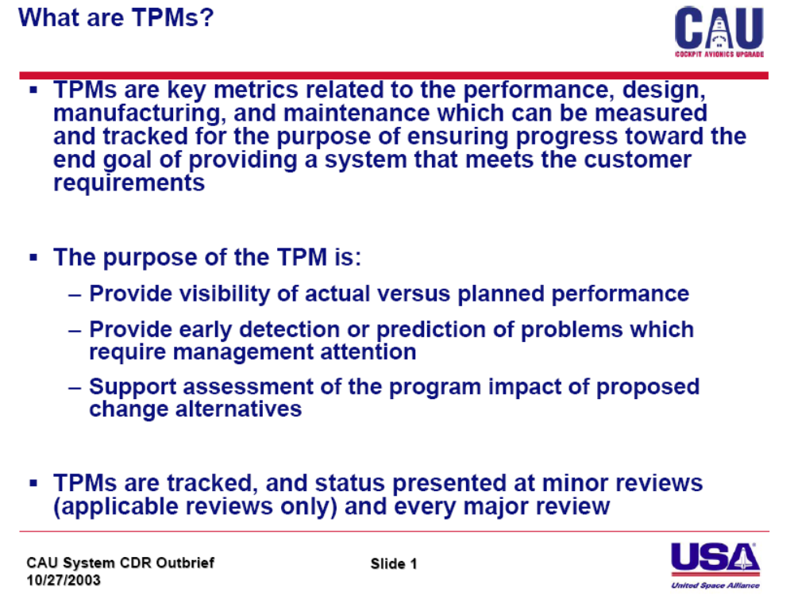
Notes:
This is a great explanation of the purpose of TPMs.

Slide 7
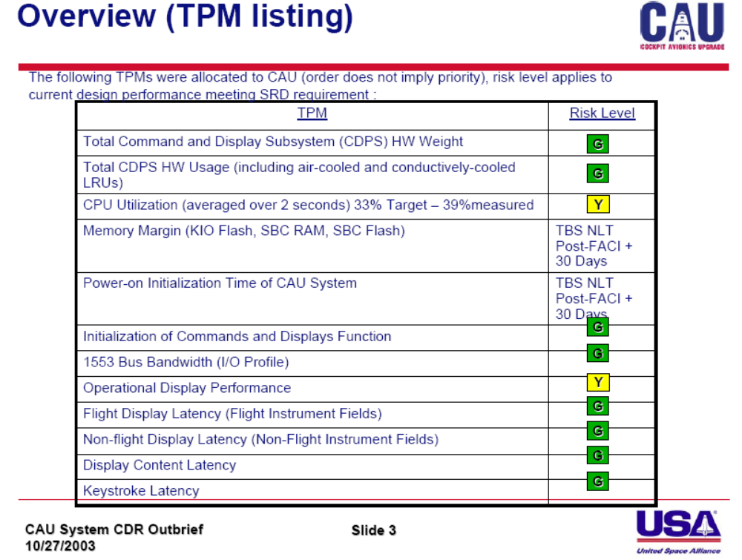
stoplight chart
Notes:
These are the TPMs for this project which was to add software and hardware to make the shuttle cockpit easier to use and to add capabilities to handle aborts or malfunctions. This is called a stoplight chart. A stoplight chart provides a simple way of summarizing a project’s status. Their use is somewhat controversial. Although they provide an efficient way to communicate desired information, they also tend to discourage questions and inquiry. The people being briefed with a stoplight chart are dependent on the integrity of people who perform their assessment. Still they are popular, particularly among senior managers who have to deal with many different topics. You can see several software related topics here such as cpu utilization, memory margin, power on initialization time and latency. These are very common TPMs in software systems.

Slide 8
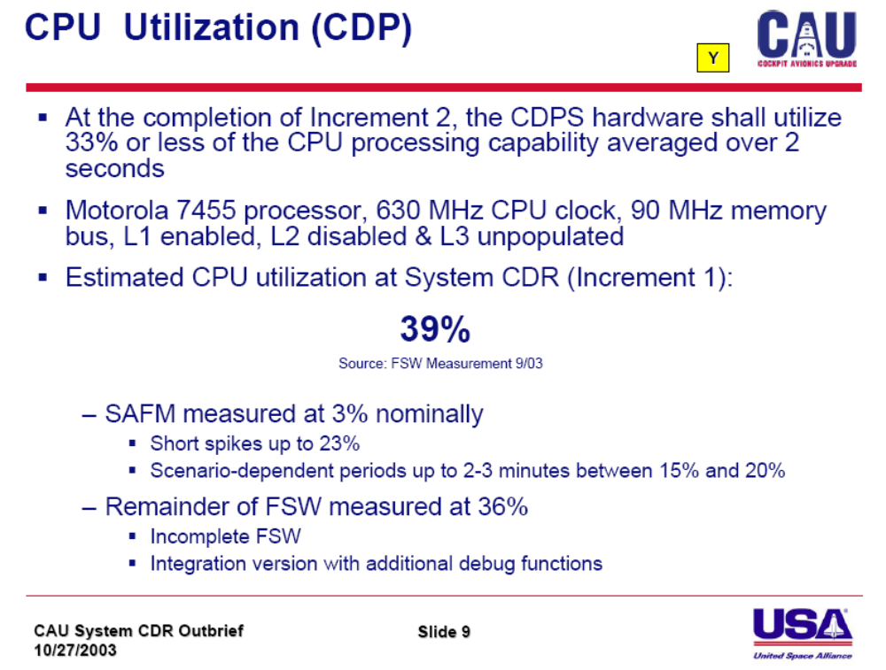
Notes:
As you can see, the software here was taking a small amount longer to execute than the original requirement. This actually is very good considering the difficulty in estimating code requirements.

Slide 9
Levels of Verification
Just as we put together a system with a system VEE, we can put together software systems
  Many of the VEE concepts came from software engineering
Levels of Verification
  Unit, Component or module test – individual module of code tested with comprehensive test of possible input conditions
  Major function test – combination of modules to test a specific sub-function of a software system
  System level test – integrated test of all functions for functionality and performance
  Stress test – running at highest input rates to see where a system might stop functioning
  User input – test all possible (including illegal) user inputs for error trapping
  Representative Operational Scenarios
  Actual Mission Scenarios
Regression testing
  When you have made software changes you
    Test the software you changed
    Test the software you haven’t changed to see if the changes you made have an impact on the software you didn’t explicitly change
Hardware/Software Interface test - run on actual flight type hardware in a lab with simulated environment and external systems

Slide 10
Independent Test – Independent Verification and Validation (IV&V)
An important thing to remember about flight software testing is that final testing must be conducted by people other than the developer
  The developer tests software the way they intended it to be used. In actual use, it may be operated differently.
  As such it is best, after developmental testing is complete, for the software to be tested by someone other than the developer. Preferably by someone who is aware how the user/operator will use the software
For critical software, Independent Verification and Validation (IV&V) is performed.
  IV&V is when a separate organization is charged with determining
    If the software meets all requirements (verification)
    If the requirements are complete and correct (validation)

Slide 11
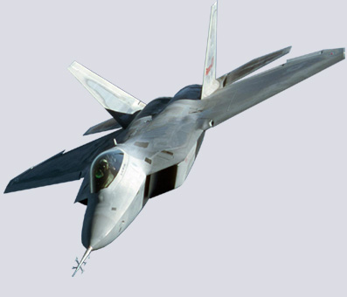
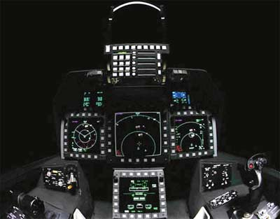
F-22 Software problem
"The new US stealth fighter, the F-22 Raptor, was deployed for the first time to Asia earlier this month. On Feb. 11, twelve Raptors flying from Hawaii to Japan were forced to turn back when a software glitch crashed all of the F-22s' on-board computers as they crossed the international date line. The delay in arrival in Japan was previously reported, with rumors of problems with the software. CNN television, however, this morning reported that every fighter completely lost all navigation and communications when they crossed the international date line. They reportedly had to turn around and follow their tankers by visual contact back to Hawaii. According to the CNN story, if they had not been with their tankers, or the weather had been bad, this would have been serious."

Slide 12
Boundary Conditions For Flight Software
Be Sure to test
Crossing the datelines
Crossing the equator
Going over the poles
F-22 bug
F-16 initial software release had a bug that would have resulted in autopilot flying aircraft inveretd when it crossed the equator. Problem discovered in ground test.
Boeing 777
Inertial Navigation
System had some
initial problems
crossing the North Pole.
Problems discovered in
flight test.
Always look for the boundary
conditions

Slide 13
F-22 problem – rough explanation
Software had been tested crossing the dateline
Hardware had been tested for this condition
Software and hardware had not been tested for this condition when integrated
Hardware response to this condition was not what the flight software was expecting
This caused navigation failure which affected satellite based communications and the autopilot

Slide 14
How can software changes in one area affect “unchanged” software
Change in data values passed across a data interface
One software can grab all the resources (cpu, memory, bandwidth, peripheral devices) depriving other software of the resources required to do its job
  Memory leak – a program with a bug that is intended to use and then release memory but doesn’t release all of it due to an indexing problem
    Run long enough, a program like this can grab all of the available system memory
One set of software can contaminate the data spaces of another by overwriting memory
  Used to be a big problem, modern languages/operating systems reduce this
  Common or global variables
  shared by many programs can be corrupted

Slide 15
Facilities for software testing
Software Development Facility (SDF) – contains sufficient computer hardware and software to perform first three levels of test (unit, function and system)
  May have actual flight hardware, hardware of common architecture to flight hardware or a software based flight hardware simulator
  Usually has simulated subsystem models and simulated environments
Systems Integration laboratory (SIL)
  Used to test hardware/software interface
  Actual flight hardware required for avionics, may have simulated systems and environment
Some small programs have a common facility to do SDF and SIL
Flight simulator – may be used to test human-system interaction if flight code is used or a flight equivalent human interface is established
Flight Vehicle Hardware In The Loop test – hook data simulators to actual flight vehicle to “fool” the vehicle into believing that it is flying in order to run representative mission scenarios
Flying testbeds/Inflight Simulation – used to test subparts of software such as radar, electronic warfare, communications, weapons, navigation, flight control

Slide 16
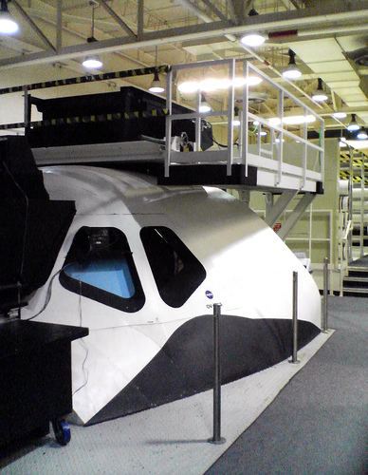
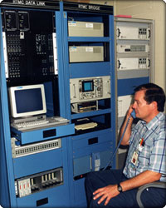
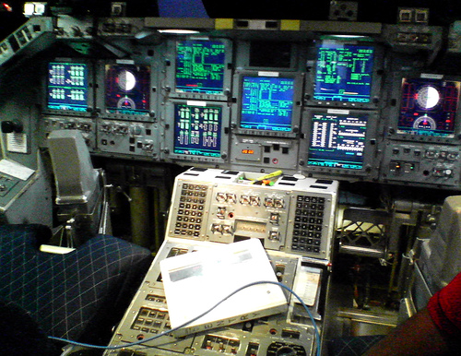
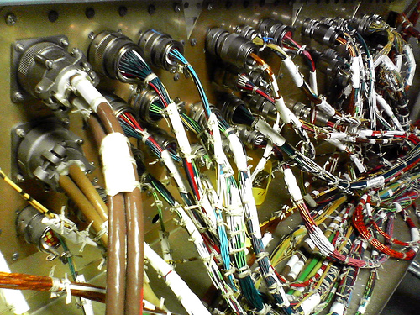
Special test equipment to monitor and simulate shuttle systems
Mockup cockpit
And visuals
Cockpit and Flight Deck Avionics
Shuttle Avionics Integration Laboratory – An example of a SIL
All avionics hardware and wiring in flight configuration
Notes:
The SAIL (Shuttle Avionics Integration Laboratory) is an example of a Systems Integration Laboratory (SIL). It contains at least one element of every type of hardware in the system, preferably a full production set including redundant backup units. They are connected with flight equivalent wiring and cooling systems. They drive a full cockpit which may have animate visuals to help the crew in flying tasks during software tests. Models, both hardware and software, simulate the equipment beyond the avionics, so that system sofwtare functional testing can be performed. The main purpose of the SIL is to determine the hardware-software compatibility of the various components in the avionics (or electronics) elements although the SIL functionality can extend into other critical systems.

Slide 17
Software Builds
Often times we have to build the software for a given mission or configuration of hardware by combining mission unique data and software
This process is often called mission build or reconfiguration
This is very common when one set of software is general enough to be used for various missions or multiple configurations
We have to manage both the software and the mission or configuration unique data
Usually a build or configure program is used to combine the data and the code
Once the system is built, it is tested and then released for use

Slide 18
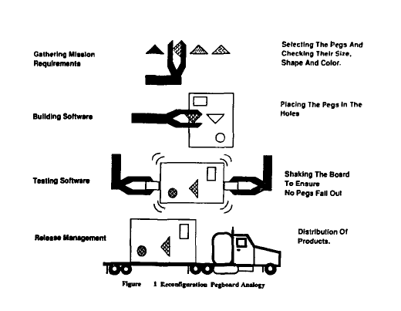
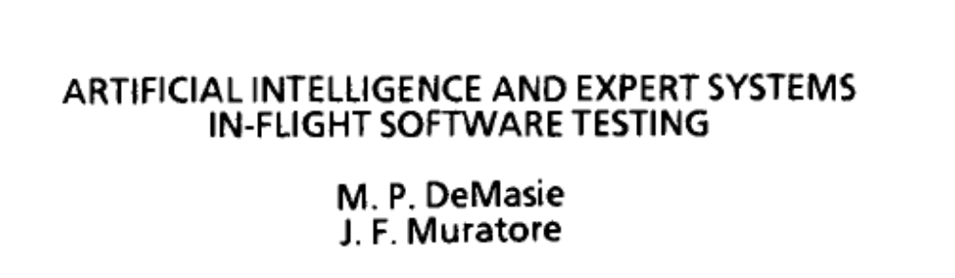
From:
Notes:
This diagram shows the problems in building a mission specific set of software from a more general set of applications software. A good example of this would be taking common software modules to build a configuration of software to operate a specific configuration of aircraft or to fly a particular space mission. This example was drawn from the software for the Space Shuttle. The specific mission requirements must be gathered, such as orbital altitude, inclination, payload mass, engine performance, time of year, etc… The proper values for all of these variables are inserted into the software as inputs or “built” into the mission load. This load is tested and then delivered to the users for use. Using a “pegs in a board” analogy, the basic software is the board with different shaped holes in it for different functional variables. In the process of developing mission requirements, we select the “proper color pegs” for the specific mission to be placed in the appropriate holes. In the build, we actually put the pegs in the board. In test , we shake the pegs to make sure they all fit correctly and work together. Then we deliver the complete load, pegs and board, to the user for a specific mission.

Slide 19
Computer Aided Software Engineering (CASE)
Just as Computer Aided Design tools help the hardware designer create systems, Computer Aided Software Engineering Tools help software designers to design, build and test software
Typical CASE functions include
  Configuration control – ensuring all users have the same copies of code and data and only allowing one user to modify code and data at a time
  Common data definitions
  Test tools – enable the testing of software modules when other pieces of the system are not yet available
  Analytical tools – estimate complexity, test coverage

Slide 20
Software Cost Models and some rough metrics
Estimating software costs is a complex tasks
Several excellent models exist including Constructive Cost Model (COCOMO)
  These models start with a basic estimate of code and then adds cost multipliers for complexity, deployment environment, languages and tools, experience of personnel etc,,,
  The values for these multiplier factors have been developed based on previous programs and the use of regression analysis
Rules of thumb – writing code
  15 SLOC of production code per day is average
  This is a figure of merit that considers total finished code divided by total programmer effort
    production code includes debugging etc.. Although not formal independent test
  20-50 SLOC per day would be the high end of the range
Rules of thumb – Maintaining code
  It takes approximately one person year of effort to keep 30k SLOC running and maintained
    This is maintenance – keeping up with other changes in the system and make work fixes for discovered minor discrepancies . This is not for adding new capabilities

